Slide 1
CQ: What is a capsule hotel and who would want to stay in one?

Slide 2
Activity:
Look through the key terms sheet provided and read the definitions carefully to make sure you understand what they mean.

Slide 3
RESEARCH TASKS:
To start, we need to be able to define domestic tourism, inbound tourism and outbound tourism. After you have done this, give an example for each.
Write a couple of sentences explaining what you think tourism is and who it affects
Research one domestic tourist destination and give 5 facts for that location
Research an outbound tourist destination and give 5 facts for that location

Slide 4
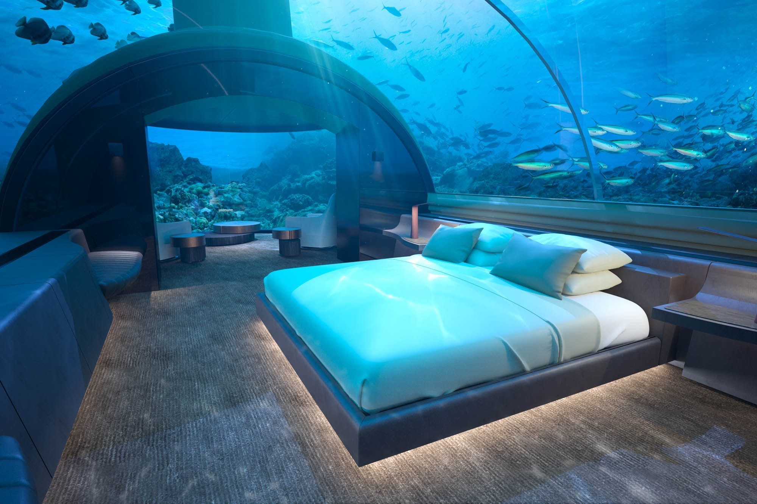
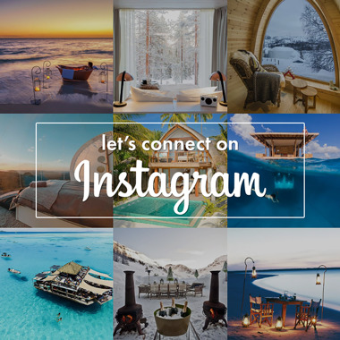
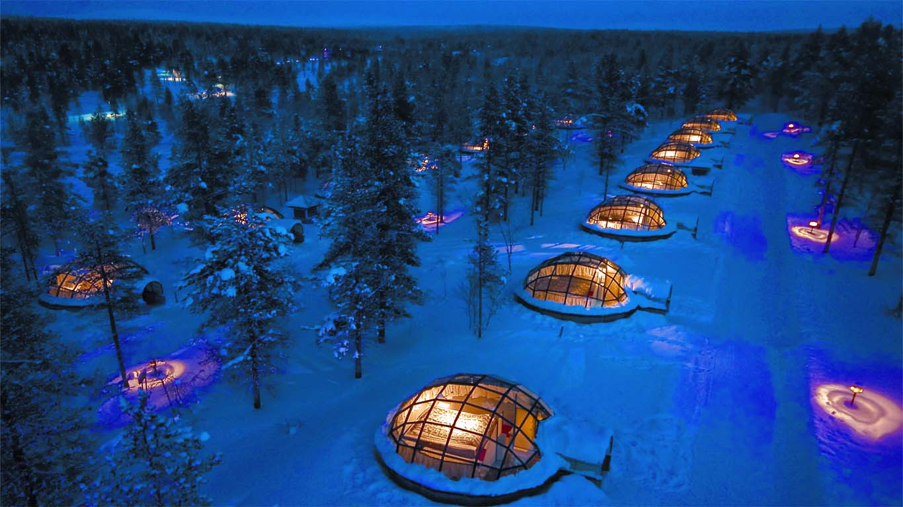
Activity: Key Terms
Define these key terms and give an example for each: Leisure travel, corporate travel, specialist travel, visiting friends and relatives and day trips.
List as many types of accommodation as you can think of.

Slide 5
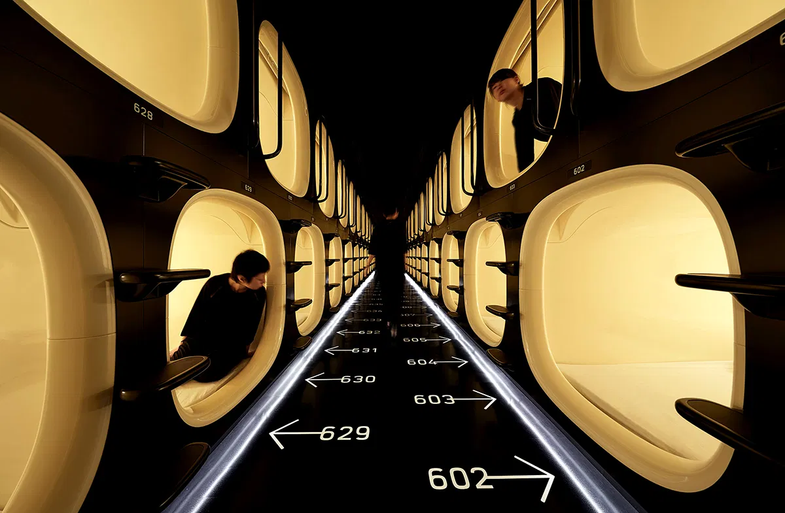
Who would this appeal to more?
Tokyo’s capsule hotels
Cheaper alternative
WIFI provided
Basic facilities
Good for shorter stays
Cooperate travellers
Families
Couples
Disabled travellers
Justify your answer- Why…..

Slide 6
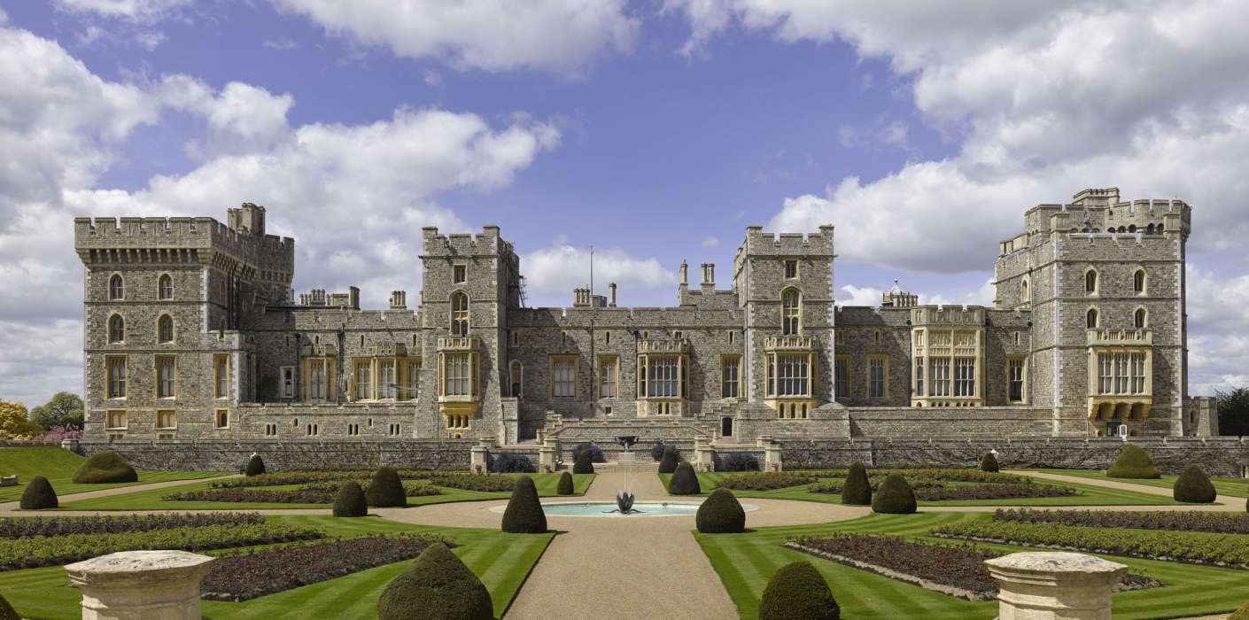
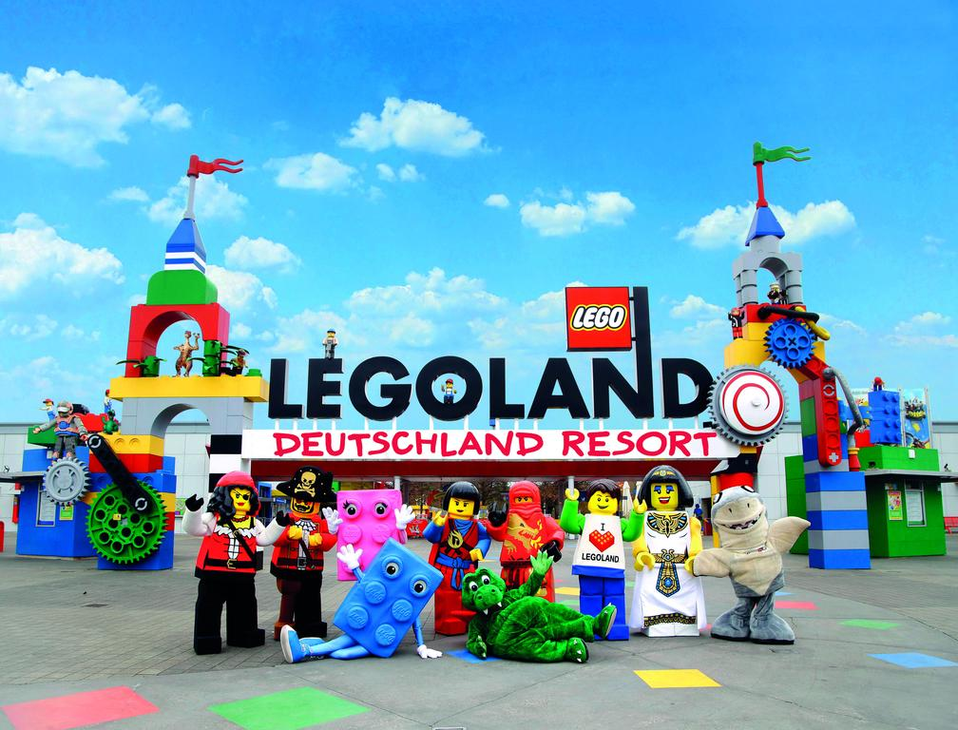
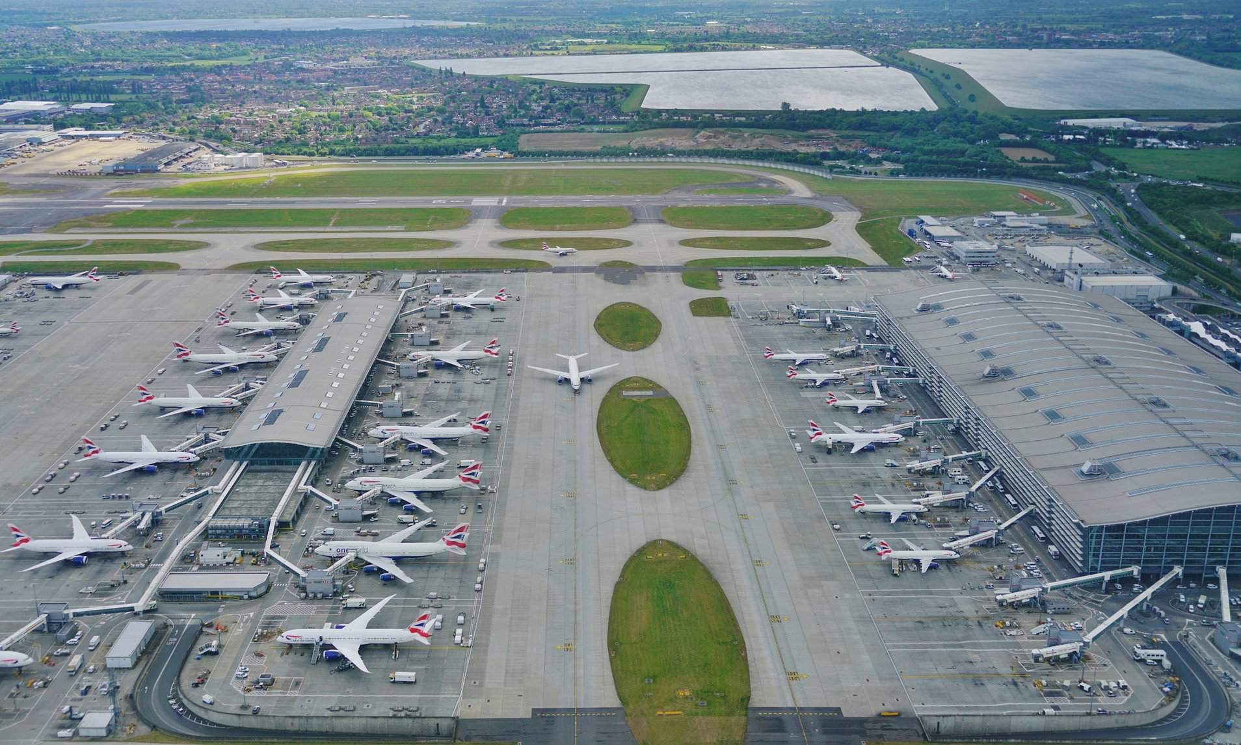
Finally….
Choose a tourism organisation in the local area. E.g. Attraction- Legoland. Hotel- Hilton Reading Transport- Railair
This could be a hotel, tourist attraction or transport company.
Create a PowerPoint Presentation on your chosen tourist organisation answering the following questions.
Is the tourism organisation effective? How do they attract customers? Is the advertising effective?
Are they growing? Why?
What type of customers do they attract?
Include statistics e.g. Inbound/ Outbound travellers to Heathrow

Slide 7
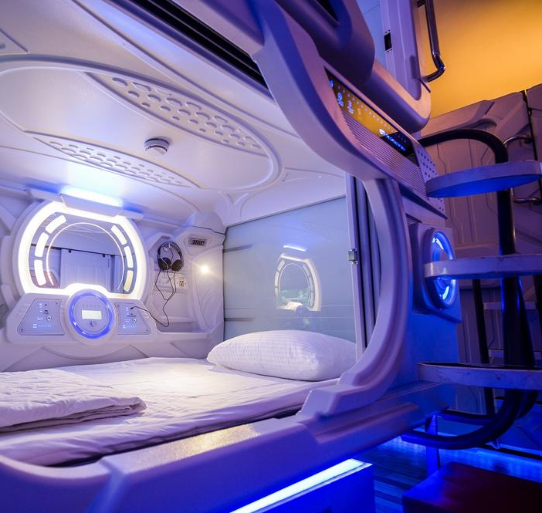
Answering the CQ: What is a capsule hotel and who would want to stay in one?
We briefly touched upon the world-renowned capsule hotels in Tokyo.
- Use what you have learnt today and your own research to answer the CQ.

