Slide 1
CQ: What are the trends in Travel and Tourism?

Slide 2
Research
Find out what is ABTA
What do they do?
What country do they operate in?
When were they established?

Slide 3
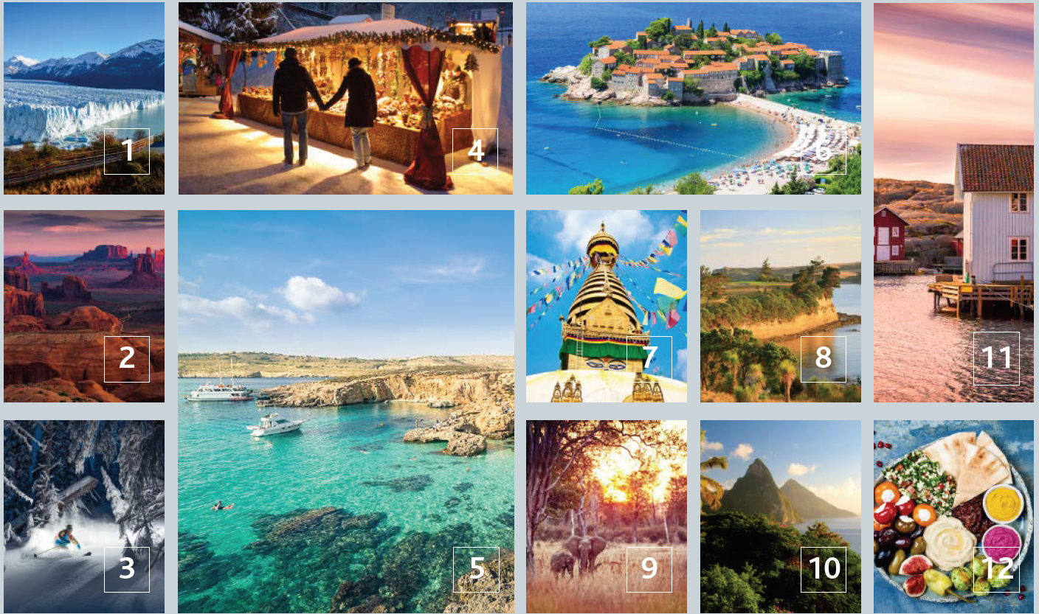
Quiz: Name the ‘up and coming’ destinations

Slide 4
Answers: how many did you get?
Argentina- Steaks, Patagonia and Iguazu falls
Arizona- Iconic landscapes and westerns
British Columbia- Winter sports, hiking and snow
Germany- Architecture, orchestras and cultural melting pot
Malta- History, beaches and diving
Montenegro- unspoilt countryside and Adriatic sea
Nepal- Spiritual heartland, wildlife and mountains
New Zealand- Diverse scenery, stunning coastline and wine
Rwanda- Lush and diverse forests and wildlife
St. Lucia- Caribbean crystal with amazing diving
Sweden- Stunning countryside, Baltic beaches and beautiful towns
Turkey- Rich history, value-for-money, incredible beaches

Slide 5
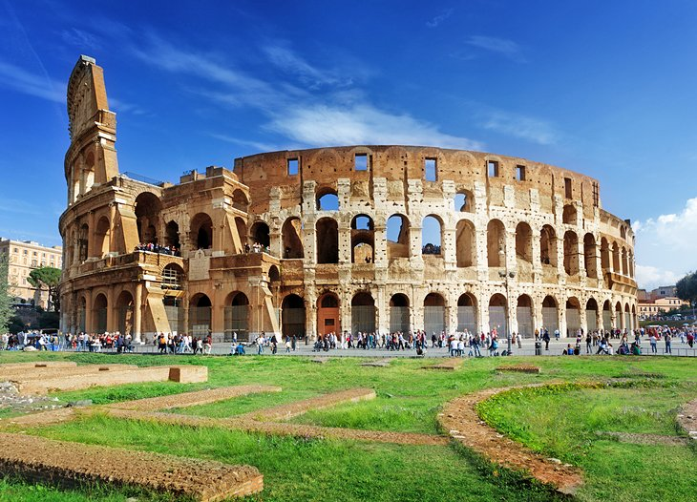
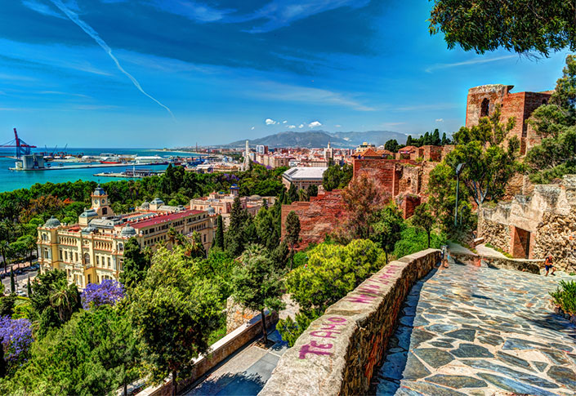
Activity: Choose 3 of the locations from the quiz!
Explain why the locations you have chosen are ‘up and coming’ in a report on the top 3 places to visit in 2021!
You need to include pictures and attractions in the places you have chosen
E.G Top 3 places to visit in 2021!
Rome is the place to visit in 2021 due to the historical heritage of the city. With ancient promenades leading to world renowned sites such as the Colosseum, make Rome your number 1 place to visit next summer. Furthermore, the weather…

Slide 6
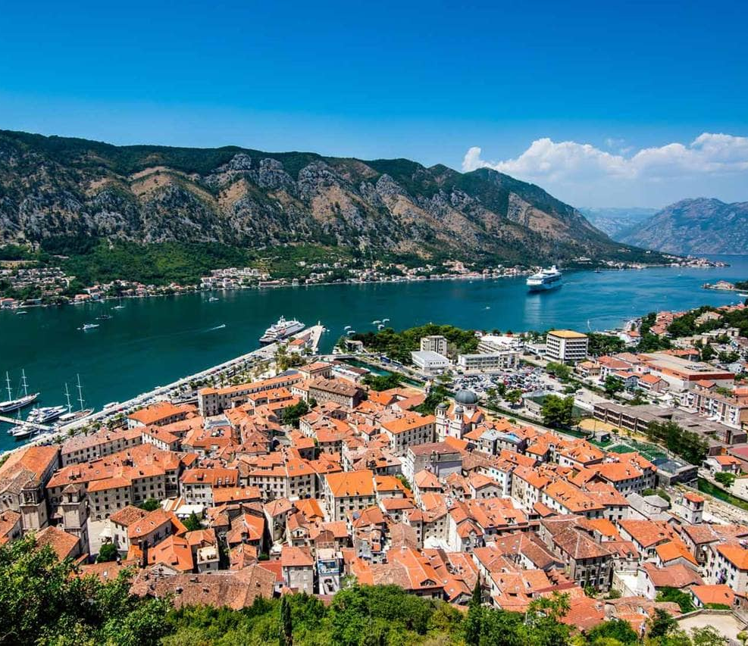
Research
Read through the Travel Trends of 2018 (PDF attached)
Create a poster to highlight a key trend of your choice with your own research. E.g. The rise of tourism in Montenegro
This should be eye catching and show the true trends of the travel industry.

Slide 7
Watch the documentary
https://www.channel4.com/programmes/thomas-cook-rise-fall-of-a-travel-agent
Create a fact file of 10 facts about the collapse of Thomas Cook.
How did it impact the industry as a whole?
Was this the worse thing that could happen to the travel industry to date?

Slide 8
The effect of a pandemic on tourism
Covid-19 is a pandemic and has had unpresented impacts around the globe, effective every industry including the tourist trade.
Using your own research, answer the following questions.
What impact has the virus had on flights?
Have any tourism companies gone into administration/ collapsed during this crisis?
STA travel has been in the news negatively during this, why?
Can you find any statistics on the financial losses people face due to coronavirus?
When will the tourist trade recover?

Slide 9
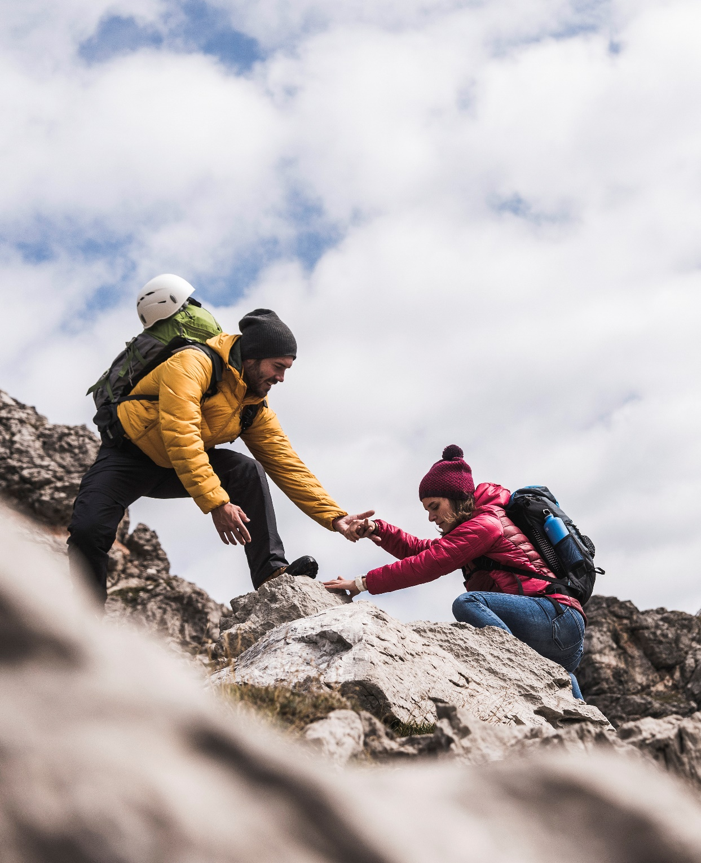
Answering the CQ:
At the start of the lesson you wrote today’s critical question. Your task is to now answer that question.
CQ: What are the trends in Travel and Tourism?

