Slide 1
CQ: Why is Travel and Tourism so diverse?

Slide 2
Types of visitors
Write a brief description on the following types of visitors. What would they need if they were to visit your chosen destination?
individuals
couples
families
groups
domestic visitors
inbound visitors
customers with specific needs, e.g. different languages or cultures; visual, hearing or mobility needs.

Slide 3
Types of visitor attractions
Create a poster about the following types of visitor attractions available in London. Include the following:
purpose built,
natural
theme and water parks
historical sites such as castles, stately homes, walls, ruins
wildlife and nature such as marine world, zoo, safari park
arts and entertainment such as sports stadiums/events, theatres, art galleries, museums, festivals, exhibitions, local events

Slide 4
Promote the Olympic Stadium
Create promotional materials to promote stadium tours at the Olympic Stadium in Berlin.
Include the history of the stadium and also how much it costs to enter.

Slide 5
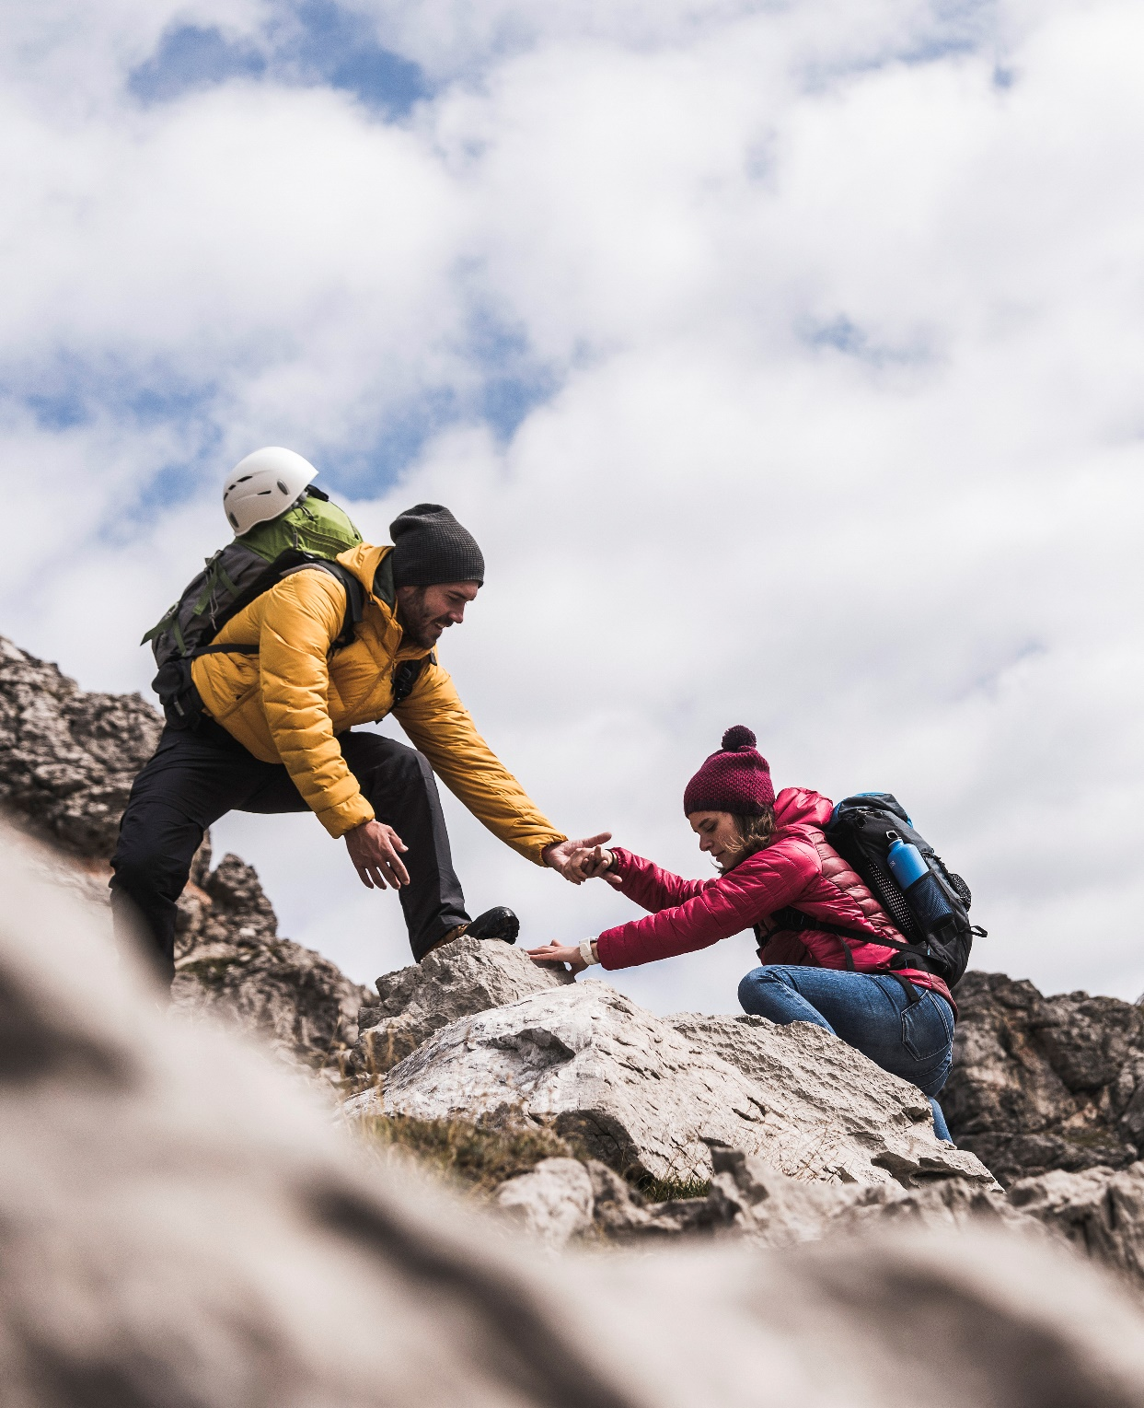
Answering the CQ:
At the start of the lesson you wrote today’s critical question. Your task is to now answer that question
Why is Travel and Tourism so diverse?

