Slide 1
Welcome to Travel and Tourism
Introduction to the Course

Slide 2
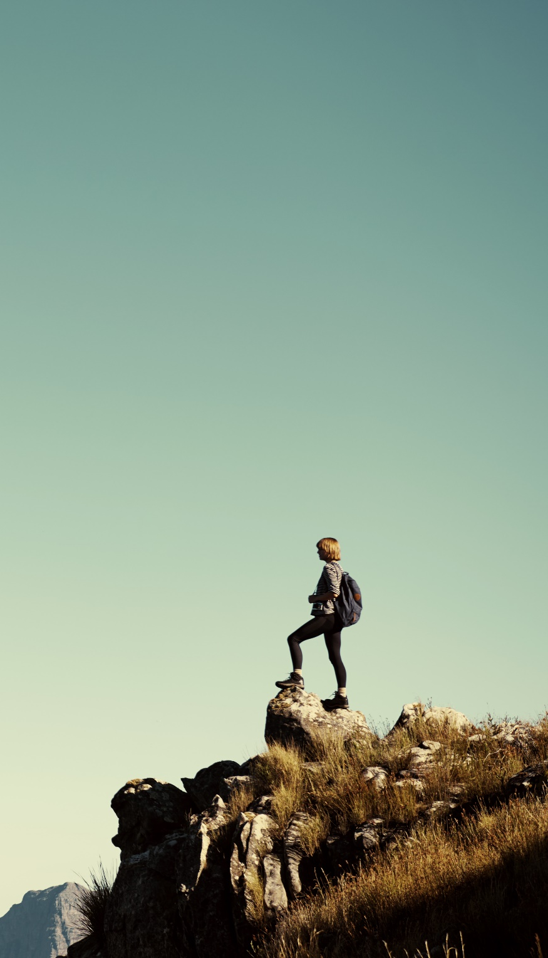
About the course
3 mandatory units
1 optional unit
2 of these units are coursework
2 of these units are external exams

Slide 3
Units you will study:
Unit 1 – The World of Travel and Tourism (Exam)
Unit 2 – Global Destinations (Exam)
Unit 3 – The Principles of Marketing in Travel and Tourism (Coursework)
Unit 9 – Visitor Attractions (Coursework)

Slide 4
Where Am I?
It is important as a Travel and Tourism student to know where key places are in the world.
I will show you a serious of key landmarks or destinations.
Your task is to identify the place and correctly label it on a piece of paper.
It doesn’t need to be specific to the place just the correct country.

Slide 15
Answers:
Eiffel Tower, Paris, France
Disney World Orlando, Florida, USA
Grand Canyon, Arizona, USA
Pyramids of Giza, Egypt
Mount Everest, Nepal
The Colosseum, Rome, Italy
Sydney Opera House, Australia
Sagrada Familia, Barcelona, Spain
Christ the Redeemer, Rio de Janeiro, Brazil
Downtown Tokyo, Japan
HOW MANY DID YOU GET RIGHT?
0-4 : Stay at home type
5-7 : Just about moving and shaking
8-10: Great! Well-done World Traveller

Slide 16
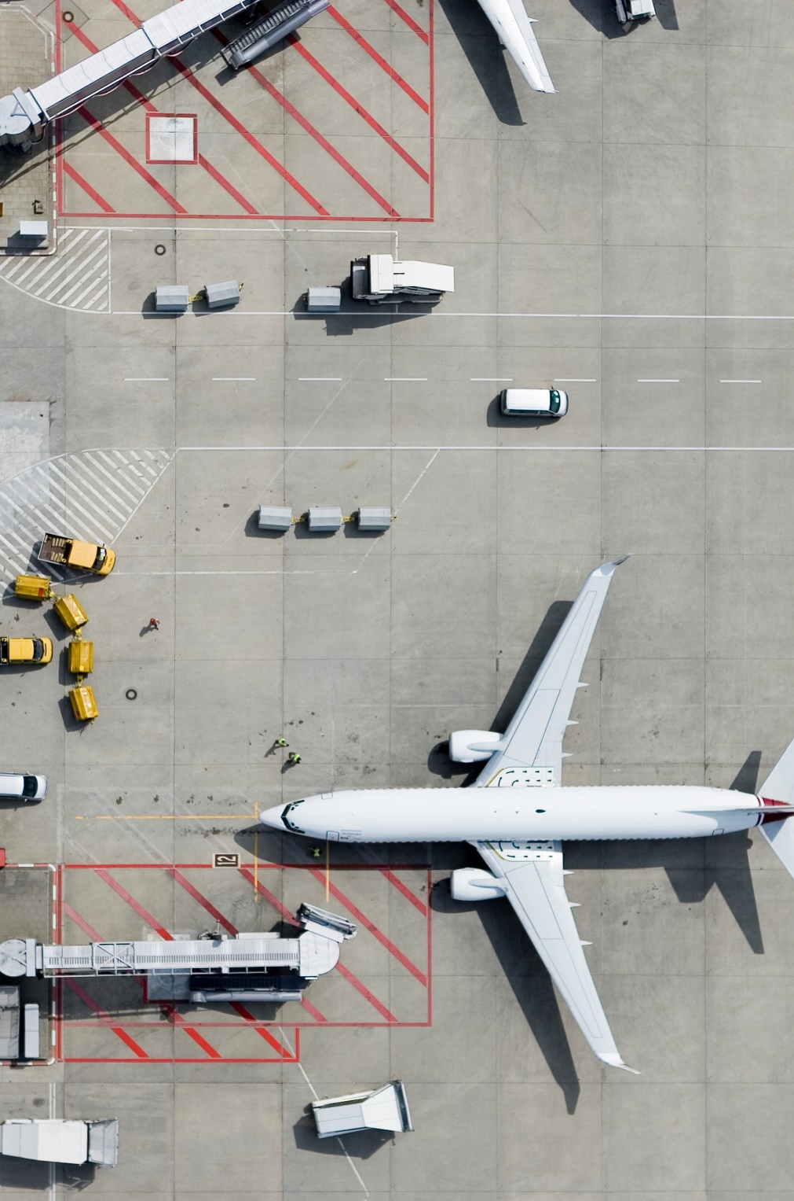
What’s the appeal?
Throughout the course you will have to look at different destinations and attractions and how they appeal to different groups of people.
Task – Watch the following two videos and think about the appeal to different types of tourists.

Slide 17
Iceland
https://www.youtube.com/watch?v=vzSHcyXfNPw
Would this appeal to families?
Would this appeal to couples?
Would this suit a school trip?

Slide 18
Florida
https://www.youtube.com/watch?v=nwiBOYYBMMc
Would this appeal to families?
Would this appeal to couples?
Would this suit a school trip?

Slide 19
What to do now
Research a holiday of your choice.
It must be suitable for a family of 4 consisting of 2 parents and 2 teenagers. You can go anywhere in the world but must travel during 10-23rd April.
They have a budget of £2500.
They need activities suitable for their teenagers.

